Slide 1

Transactions & Wallets: Keys, Addresses, and Sending Value
Welcome to our blockchain journey. Today, we'll demystify crypto wallets and transaction processes. Understanding these fundamentals is crucial for secure and efficient blockchain interactions.

Slide 2
What is a Crypto Transaction?
Definition
How it Works
A crypto transaction records value transfer on a blockchain. It's an irreversible entry in a public ledger.
When you send crypto, you authorize a network update. For example, Alice sends 0.05 ETH to Bob, reducing Alice's balance and increasing Bob's.

Slide 3




Wallets – Purpose and Role
Key Storage
Signing Transactions
Blockchain Interaction
A crypto wallet primarily stores your cryptographic keys, not the crypto itself. It's a tool for managing your digital assets.
Wallets use your private key to digitally sign transactions. This proves ownership and authorizes transfers on the blockchain.
Wallets interact directly with the blockchain network. They broadcast your signed transactions for validation and inclusion in blocks.

Slide 4

Public and Private Keys
Asymmetric Encryption
Public Key (Address)
Private Key (Password)
Crypto uses asymmetric encryption, creating a pair of unique keys. One encrypts, the other decrypts.
This is your shareable account address. Anyone can send you crypto using this key.
This is your secret password. Keep it absolutely confidential to control your funds. It's like the key to your mailbox.

Slide 5




How Addresses Are Generated
Private Key
A random, secret number.
Public Key
Derived from the private key via cryptographic math.
Address
Generated by hashing the public key. For example, Ethereum addresses are derived from the last 20 bytes of the Keccak-256 hash of the public key.

Slide 6
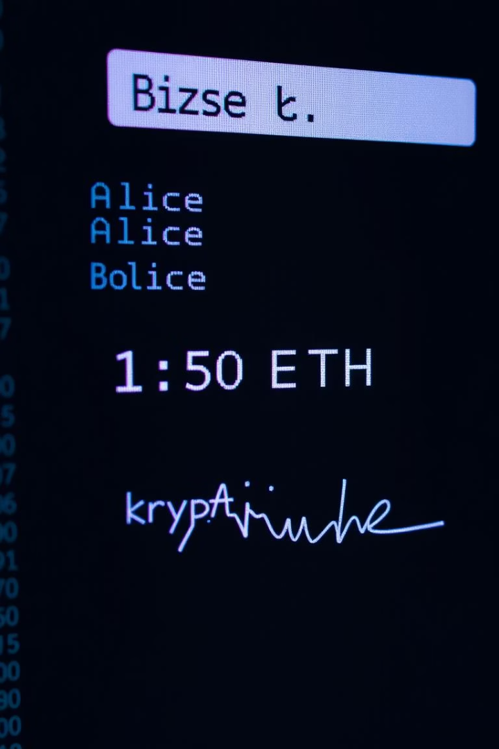
Anatomy of a Transaction
1
Transaction Details
Includes sender, receiver, amount, and a unique digital signature.
2
Gas/Fees
A small fee paid to network validators for processing your transaction.
3
Broadcast & Validation
The transaction is broadcast and validated by network nodes.
4
Block Confirmation
Once confirmed, the transaction is added to a new block, making it immutable.

Slide 7
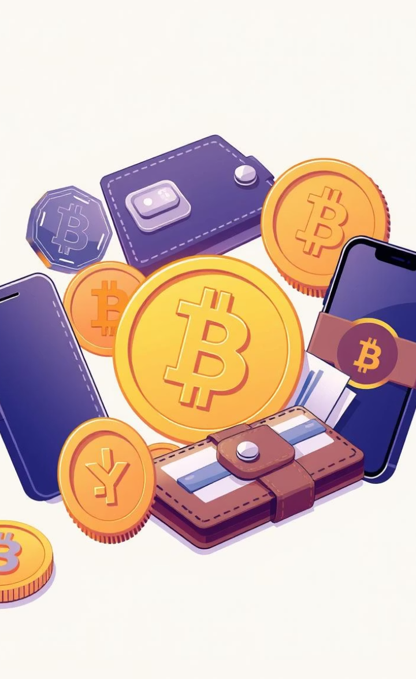
Types of Wallets
—
Hot Wallets
Connected to the internet, like MetaMask. Convenient for frequent transactions, but less secure.
—
Cold Wallets
Offline storage, like Ledger. Highly secure for long-term holding.
—
Custodial
Third party holds your keys, like Binance Wallet. Easy to use, but you don't control your private keys.
—
Non-Custodial
You hold your own keys, like MetaMask or Ledger. Full control, but requires more responsibility.

